Slide 1
CHURN PREDICTION
Nikhil S Krishna -23
Sumanth Sanakkayala-22
Tejaswi Ayyadapu-2

Slide 2
INTRODUCTION
Telecom CHURN PREDICTION
Churn prediction is customer defection by predicting which customers are likely to cancel a subscription to a service.
Though originally used within the telecommunications industry, it has become common practice across banks, ISPs, insurance firms.
To analyse customer behaviour,following factors to be analysed
Customer demographic data (age, marital status, etc.)
Sentiment analysis of social media
Customer usage patterns and geographical usage trends
Calling-circle data

Slide 3
DATASET
SCHEMA:
1.State 2.Account length
3.Area code 4.International plan
5.Voice mail plan 6.Number vmail messages
7.Total day minutes 8.Total day calls
9.Total day charge 10.Total eve minutes
11.Total eve call,Total eve charge 12.Total night minutes
13.Total night calls 14.Total night charge
15.Total intl minutes 16.Total intl calls
17.Total intl charge 18.Customer service calls
19.Churn

Slide 4
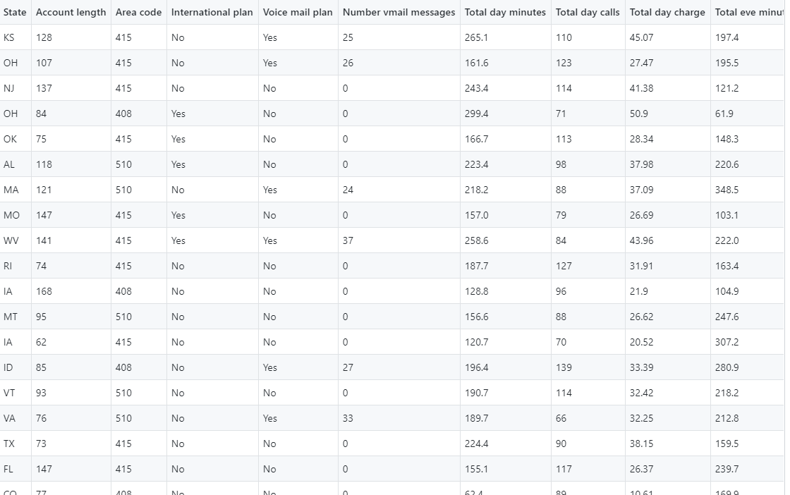
DATASET

Slide 5
PROPOSED SOLUTION
Prediction
Whether a customer has a high probability of unsubscribing from the service or not
Churn is the Label: True or False
Machine learning Algorithms we want to use:
Random forest
Logistic Regression
SVM
Comparing The Accuracy of three different Algorithms

Slide 6
Technologies
SPARK-PYCHARM
Libraries:
-pyspark

Slide 7
THANK YOU

